Slide 1
03 Search Algorithms Uninformed and Informed
CSCI 561 - Foundation for Artificial Intelligence
Professor Wei-Min Shen
University of Southern California

Slide 2
Outline
Search Algorithms
- Uninformed Search (this lecture)
Search strategies: breadth-first, uniform-cost, depth-first, bi-directional, …
- Informed Search (next lecture)
Search strategies: best-first, A*
Heuristic functions

Slide 3
Types of search algorithms

Slide 4
Concept Review
How to define a “problem”?
1.?
2. ?
3. ?
4. ?
What is a “solution”?
What is a “problem space”?
What is a “search tree”?
How to find a solution?
Where is your frontier in your search?
How to manage your “soldiers” during the search?

Slide 5
From Problem Space to Search Tree
3
A
4
B
4
C
Problem Space
S
5
5
G
4
D
E
F
3
2
4
3
S
4
4
A
D
frontier
5
5
2
Associated
loop-free
search tree
B
D
A
E
4
5
2
4
5
4
C
E
E
B
B
F
2
4
5
4
4
5
4
4
3
D
F
B
F
C
E
A
C
G
3
4
3
4
G
C
G
F
G
3

Slide 6
Remember: Implementation of search algorithms
Function General-Search(problem, Queuing-Fn) returns a solution, or failure
nodes <- make-queue(make-node(initial-state[problem])) // the frontier
loop do
if nodes is empty then return failure
node <- Remove-Front(nodes) // command your soldiers
if Goal-Test[problem] applied to State(node) succeeds then return node
nodes <- Queuing-Fn(nodes, Expand(node, Operators[problem])) // organize your soldiers
end
Organizing your soldiers at the frontier:
Queuing-Fn(queue, elements) is a queuing function that inserts a set of elements into the queue and determines the order of node expansion. Varieties of the queuing function produce varieties of the search algorithm.

Slide 7
Remember: Implementation of search algorithms
Function General-Search(problem, Queuing-Fn) returns a solution, or failure
nodes <- make-queue(make-node(initial-state[problem])) // the frontier
loop do
if nodes is empty then return failure
node <- Remove-Front(nodes) // command your soldiers
if Goal-Test[problem] applied to State(node) succeeds then return node
nodes <- Queuing-Fn(nodes, Expand(node, Operators[problem])) // organize your soldiers
end
Organizing your soldiers at the frontier:
Breadth-first search: Enqueue expanded (children) nodes to the back of the queue (FIFO order)
Depth-first search: Enqueue expanded (children) nodes to the front of the queue (LIFO order)
Uniform cost search: Enqueue expanded (children) nodes so that queue is ordered by the path (past) cost of the nodes (priority queue order).

Slide 8
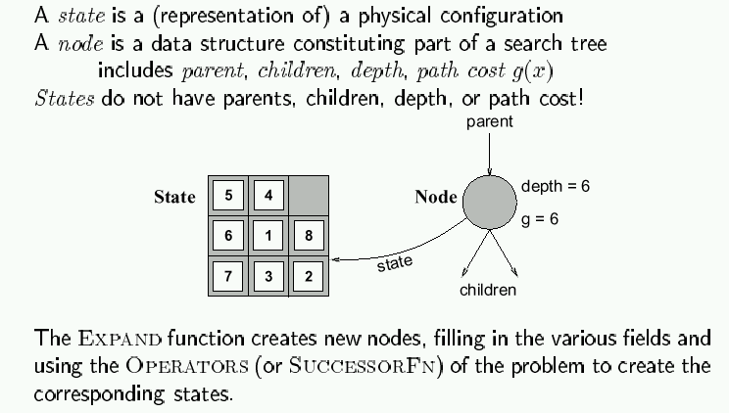
Encapsulating state information in nodes

Slide 9
How to Compare Different Search Strategies?
A search strategy is defined by picking the order of node expansion.
Search algorithms are commonly evaluated according to the following four criteria:
Completeness: does it always find a solution if one exists?
Time complexity: how long does it take as function of num. of nodes?
Space complexity: how much memory does it require?
Optimality: does it guarantee the least-cost solution?
Time and space complexity are measured in terms of:
b – max branching factor of the search tree
d – depth of the least-cost solution
m – max depth of the search tree (may be infinity)

Slide 10
A Note for Approximations
In our complexity analysis, we do not take the built-in loop-detection into account.
The results only ‘formally’ apply to the variants of our algorithms WITHOUT loop-checks.
Studying the effect of the loop-checking on the complexity is hard:
overhead of the checking MAY or MAY NOT be compensated by the reduction of the size of the tree.
Also: our analysis DOES NOT take the length (space) of representing paths into account !!
http://www.cs.kuleuven.ac.be/~dannyd/FAI/

Slide 11
Uninformed search strategies
Use only information available in the problem formulation
Breadth-first
Uniform-cost
Depth-first
Depth-limited
Iterative deepening

Slide 12
Breadth-first search

Slide 13

Breadth-first search
“First-in, first-out”

Slide 14
Breadth-first search
S
A
D
Move downwards, level by level, until goal is reached.
B
D
A
E
C
E
E
B
B
F
D
F
B
F
C
E
A
C
G
G
C
G
F
G

Slide 15
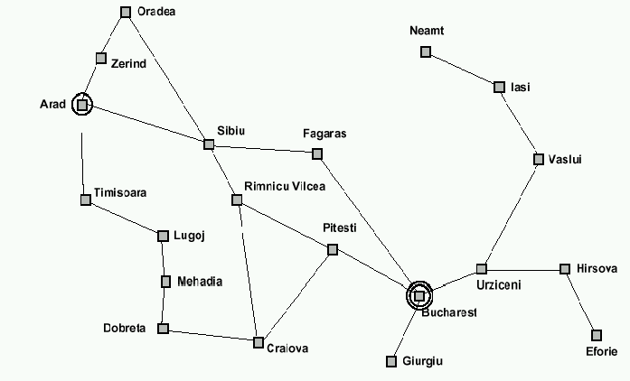
Example: Traveling from Arad To Bucharest

Slide 16
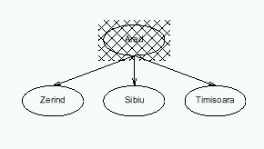
Breadth-first search

Slide 17
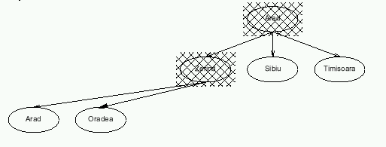
Breadth-first search

Slide 18
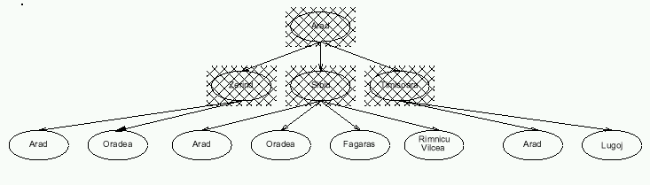
Breadth-first search

Slide 19
Properties of breadth-first search
Completeness:
Time complexity:
Space complexity:
Optimality:
Search algorithms are commonly evaluated according to the following four criteria:
Completeness: does it always find a solution if one exists?
Time complexity: how long does it take as function of num. of nodes?
Space complexity: how much memory does it require?
Optimality: does it guarantee the least-cost solution?
Time and space complexity are measured in terms of:
b – max branching factor of the search tree
d – depth of the least-cost solution
m – max depth of the search tree (may be infinity)

Slide 20
Properties of breadth-first search
Completeness: Yes, if b is finite
Time complexity: 1+b+b²+…+b^{d} = O(b ^{d}), i.e., exponential in d
Space complexity: O(b ^{d}) (see following slides)
Optimality: Yes (assuming cost = 1 per step)

Slide 21
Time complexity of breadth-first search
If a goal node is found on depth d of the tree, all nodes up till that depth are created and examined (note: and the children of nodes at depth d are created and enqueued, but not yet examined).
d
m
b
G
Thus: O(b^{d})

Slide 22
Space complexity of breadth-first
Largest number of nodes in QUEUE is reached on the level d+1 just beyond the goal node.
d
b
G
QUEUE contains all nodes. (Thus: 4) .
In General: b^{d+1} – b ~ b^{d}

Slide 23
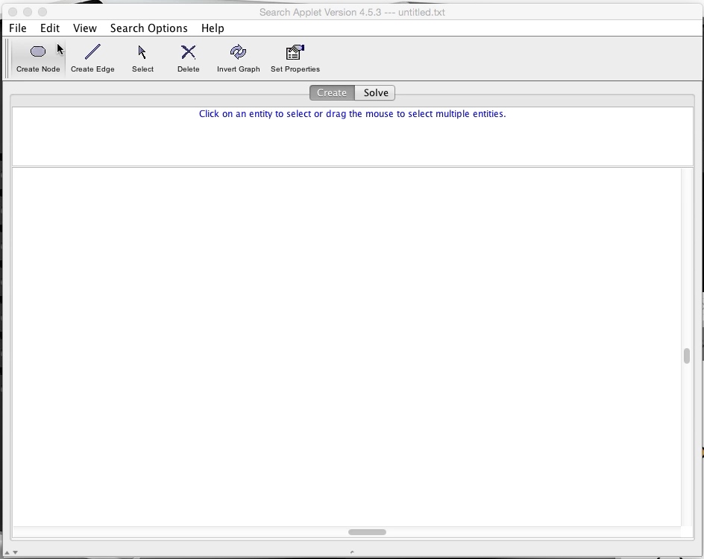
Demo

Slide 24
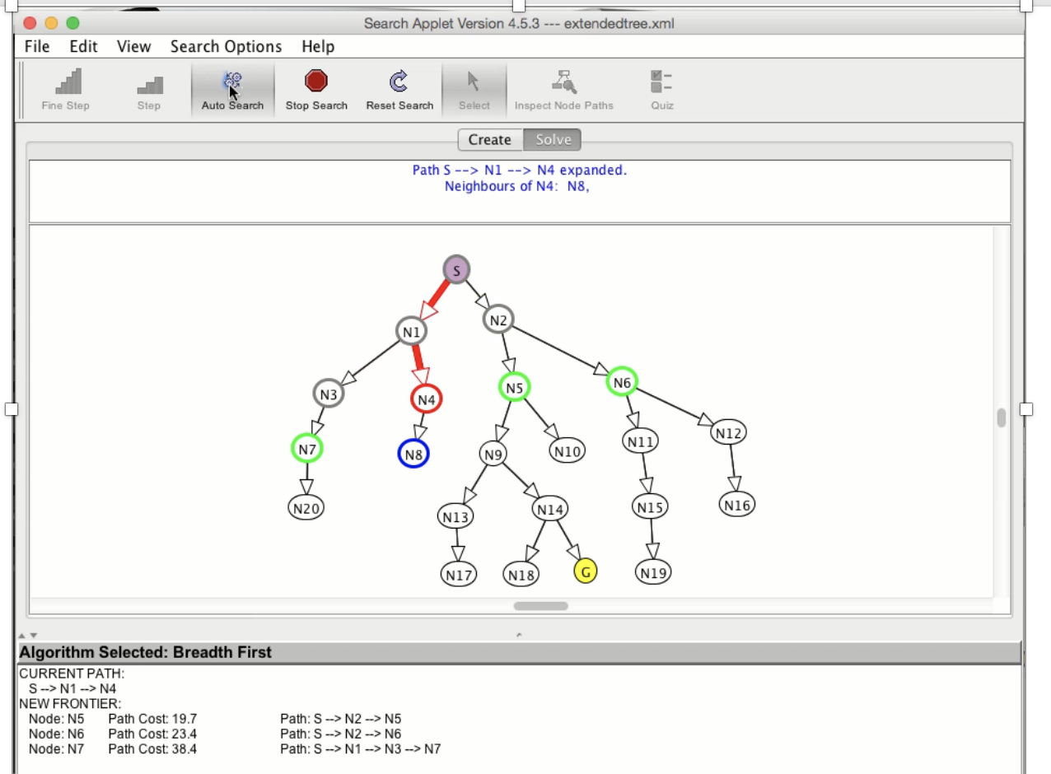
Demo

Slide 25
Uniform-cost search

Slide 26

Uniform-cost search
So, the queueing function keeps the node list sorted by increasing path cost, and we expand the first unexpanded node (hence with smallest path cost)
A refinement of the breadth-first strategy:
Breadth-first = uniform-cost with path cost = node depth

Slide 27
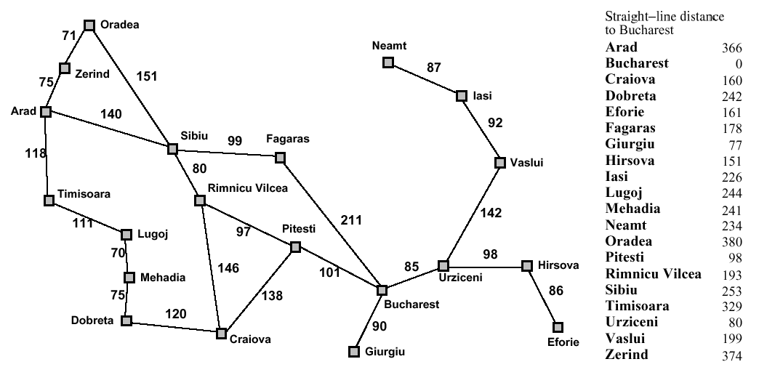
Romania with step costs in km

Slide 28
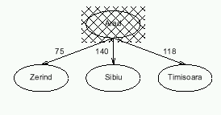
Uniform-cost search

Slide 29
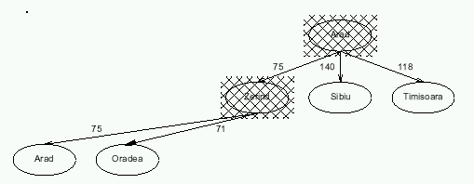
Uniform-cost search

Slide 30
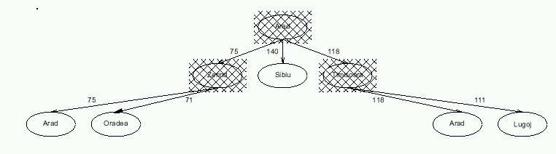
Uniform-cost search

Slide 31
Properties of uniform-cost search
Completeness: Yes, if step cost ≥ ε >0
Time complexity: # nodes with g ≤ cost of optimal solution, ≤ O(b ^{d})
Space complexity: # nodes with g ≤ cost of optimal solution, ≤ O(b ^{d})
Optimality: Yes, as long as path cost never decreases
g(n) is the path cost to node n
Remember:
b = branching factor
d = depth of least-cost solution

Slide 32
Implementation of uniform-cost search
Initialize Queue with root node (built from start state)
Repeat until (Queue empty) or (first node has Goal state):
Remove first node from front of Queue
Expand node (find its children)
Reject those children that have already been considered, to avoid loops
Add remaining children to Queue, in a way that keeps entire queue sorted by increasing path cost
If Goal was reached, return success, otherwise failure

Slide 33
Caution! Don’t Terminate the Search Pre-maturely
Uniform-cost search would not be optimal if it is terminated when any node in the queue has goal state. But is optimal if you do goal-check when a node pops up from the frontier.
1
S
1
5
A
5
1
C
2
B
5
Uniform cost returns the path with cost 102 (if any goal node is considered a solution), while there is a path with cost 25.
D
10
5
100
E
15
5
F
20
G
5

Slide 34
Note: Loop Detection
In class, we saw that the search may fail or be sub-optimal if:
- no loop detection: then algorithm runs into infinite cycles
(A -> B -> A -> B -> …)
- not queuing-up a node that has a state which we have
already visited: may yield suboptimal solution
- simply avoiding to go back to our parent: looks promising,
but we have not proven that it works
Solution? do not enqueue a node if its state matches the state of any of its parents (assuming path costs>0).
Indeed, if path costs > 0, it will always cost us more to consider a node with that state again than it had already cost us the first time.
Is that enough??

Slide 35
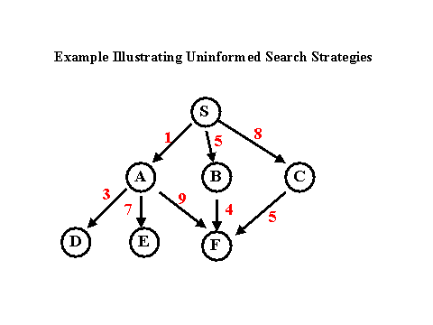
Example
From: http://www.csee.umbc.edu/471/current/notes/uninformed-search/
G

Slide 36
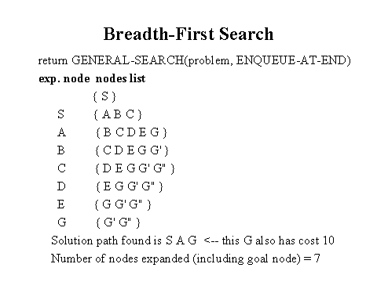
Breadth-First Search Solution
From: http://www.csee.umbc.edu/471/current/notes/uninformed-search/

Slide 37
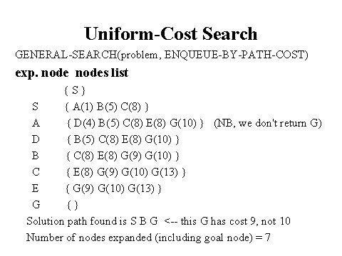
Uniform-Cost Search Solution
From: http://www.csee.umbc.edu/471/current/notes/uninformed-search/

Slide 38
Note: Queueing in Uniform-Cost Search
In the previous example, it is wasteful (but not incorrect) to queue-up three nodes with G state, if our goal if to find the least-cost solution:
Although they represent different paths, we know for sure that the one with smallest path cost (9 in the example) will yield a solution with smaller total path cost than the others.
So we can refine the queueing function by:
- queue-up node if
1) its state does not match the state of any parent // it is new
and 2) path cost smaller than path cost of any // it is better
unexpanded node with same state in the queue (and in this case, replace old node with same
state by our new node)
Is that it??

Slide 39
A Clean Robust Algorithm
Function UniformCost-Search(problem, Queuing-Fn) returns a solution, or failure
open ← make-queue(make-node(initial-state[problem])) // frontier
closed ← [empty] // already visited
loop do
if open is empty then return failure
currnode ← Remove-Front(open)
if Goal-Test[problem] applied to State(currnode) then return currnode
children ← Expand(currnode, Operators[problem])
while children not empty
[… see next slide …]
end
closed ← Insert(closed, currnode) // already visited
open ← Sort-By-PathCost(open) // frontier
end

Slide 40
A Clean Robust Algorithm
[… see previous slide …]
children ← Expand(currnode, Operators[problem])
while children not empty
child ← Remove-Front(children)
if no node in open or closed has child’s state
open ← Queuing-Fn(open, child)
else if there exists node in open that has child’s state
if PathCost(child) < PathCost(node)
open ← Delete-Node(open, node)
open ← Queuing-Fn(open, child)
else if there exists node in closed that has child’s state
if PathCost(child) < PathCost(node)
closed ← Delete-Node(closed, node)
open ← Queuing-Fn(open, child)
end
[… see previous slide …]

Slide 41
Example
S
# State Depth Cost Parent
1 S 0 0 -
1
5
A
1
C
B
5
1
D
5
100
E
F
5
G
5

Slide 42
Example
S
# State Depth Cost Parent
1 S 0 0 -
2 A 1 1 1
3 C 1 5 1
1
5
A
1
C
B
5
1
D
5
100
E
Black = open queue
Grey = closed queue
F
5
Insert expanded nodes
Such as to keep open queue sorted
G
5

Slide 43
Example
S
# State Depth Cost Parent
1 S 0 0 -
2 A 1 1 1
4 B 2 2 2
3 C 1 5 1
1
5
A
1
C
B
5
1
D
5
E
Node 2 has 2 successors: one with state B
and one with state S.
We have node #1 in closed with state S;
but its path cost 0 is smaller than the path
cost obtained by expanding from A to S.
So we do not queue-up the successor of
node 2 that has state S.
100
F
5
G
5

Slide 44
Example
S
# State Depth Cost Parent
1 S 0 0 -
2 A 1 1 1
4 B 2 2 2
5 C 3 3 4
6 G 3 102 4
1
5
A
1
C
B
5
1
D
5
E
Node 4 has a successor with state C and
Cost smaller than node #3 in open that
Also had state C; so we update open
To reflect the shortest path.
100
F
5
G
5

Slide 45
Example
S
# State Depth Cost Parent
1 S 0 0 -
2 A 1 1 1
4 B 2 2 2
5 C 3 3 4
7 D 4 8 5
6 G 3 102 4
1
5
A
1
C
B
5
1
D
5
100
E
F
5
G
5

Slide 46
Example
S
# State Depth Cost Parent
1 S 0 0 -
2 A 1 1 1
4 B 2 2 2
5 C 3 3 4
7 D 4 8 5
8 E 5 13 7
6 G 3 102 4
1
5
A
1
C
B
5
1
D
5
100
E
F
5
G
5

Slide 47
Example
S
# State Depth Cost Parent
1 S 0 0 -
2 A 1 1 1
4 B 2 2 2
5 C 3 3 4
7 D 4 8 5
8 E 5 13 7
9 F 6 18 8
6 G 3 102 4
1
5
A
1
C
B
5
1
D
5
100
E
F
5
G
5

Slide 48
Example
S
# State Depth Cost Parent
1 S 0 0 -
2 A 1 1 1
4 B 2 2 2
5 C 3 3 4
7 D 4 8 5
8 E 5 13 7
9 F 6 18 8
10 G 7 23 9
1
5
A
1
C
B
5
1
D
5
100
E
F
5
G
The node with state G and cost 102 has been removed from the open queue and replaced by cheaper node with state G and code 23 which was pushed into the open queue.
5

Slide 49
Example
S
# State Depth Cost Parent
1 S 0 0 -
2 A 1 1 1
4 B 2 2 2
5 C 3 3 4
7 D 4 8 5
8 E 5 13 7
9 F 6 18 8
10 G 7 23 9
1
5
A
1
C
B
5
1
D
5
100
E
F
5
G
5
Goal reached

Slide 50
Depth-first search

Slide 51

Depth-first search
“last-in, first-out”

Slide 52
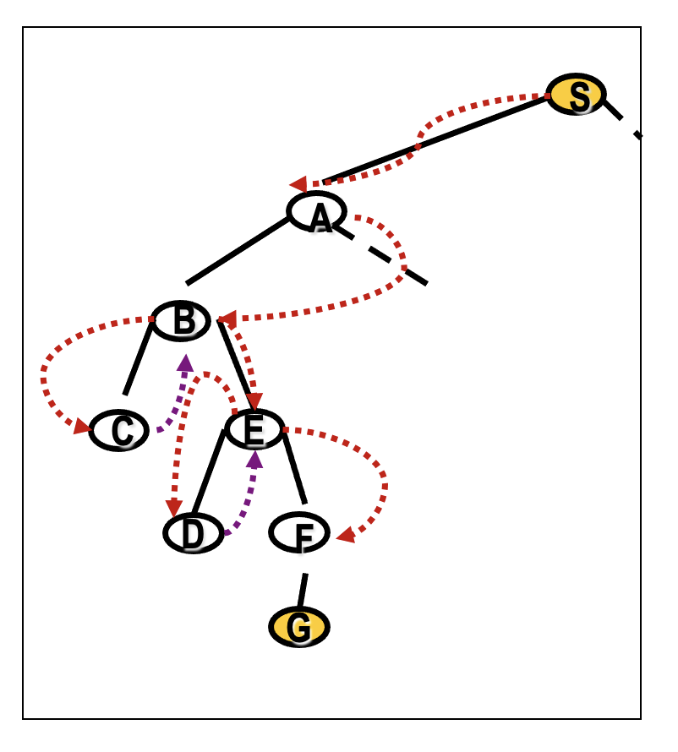
Depth First Search

Slide 53
Romania with step costs in km

Slide 54
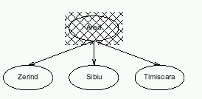
Depth-first search

Slide 55
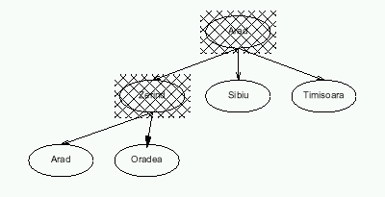
Depth-first search

Slide 56
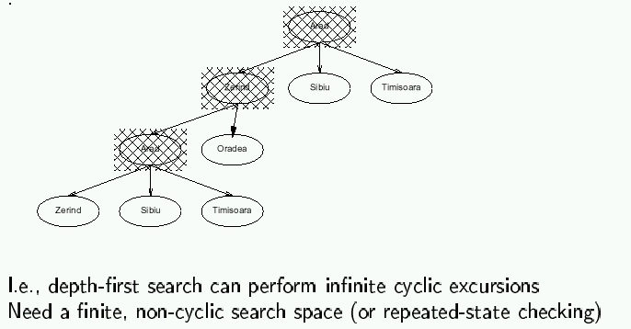
Depth-first search

Slide 57
Properties of depth-first search
Completeness: No, fails in infinite state-space (yes if finite state space)
Time complexity: O(b ^{m})
Space complexity: O(bm)
Optimality: No
Remember:
b = branching factor
m = max depth of search tree

Slide 58
Time complexity of depth-first: details
In the worst case:
the (only) goal node may be on the right-most branch,
m
b
G
Time complexity == b^{m} + b^{m-1} + … + 1 = b^{m+1} -1
Thus: O(b^{m})
b - 1

Slide 59
Space complexity of depth-first
Largest number of nodes in QUEUE is reached in bottom left-most node.
Example: m = 2, b = 3 :
G
...
QUEUE contains all nodes. Thus: 4.
In General: ((b-1) * m)
Order: O(m*b)

Slide 60
Avoiding repeated states
In increasing order of effectiveness and computational overhead:
do not return to state we come from, i.e., expand function will skip possible successors that are in same state as node’s parent.
do not create paths with cycles, i.e., expand function will skip possible successors that are in same state as any of node’s ancestors.
do not generate any state that was ever generated before, by keeping track (in memory) of every state generated, unless the cost of reaching that state is lower than last time we reached it.

Slide 61
Depth-limited search
Is a depth-first search with a limited depth l
Implementation: Nodes at depth l have no successors
Complete: if cutoff chosen appropriately then it is guaranteed to find a solution
Optimal: it does not guarantee to find the least-cost solution

Slide 62
Iterative deepening search
Function Iterative-deepening-Search(problem) returns a solution or failure
for depth = 0 to ∞ do
result ← Depth-Limited-Search(problem, depth)
if result succeeds then return result
end
return failure
Combines the best of breadth-first and depth-first search strategies.
Completeness: Yes,
Time complexity: O(b ^{d})
Space complexity: O(bd)
Optimality: Yes, if step cost = 1

Slide 63
Romania with step costs in km

Slide 64
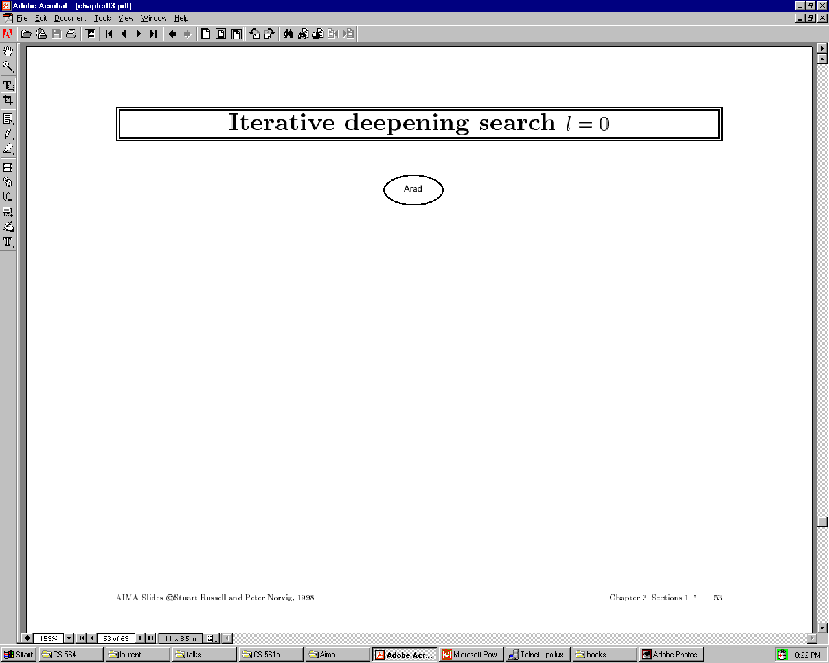

Slide 65


Slide 66
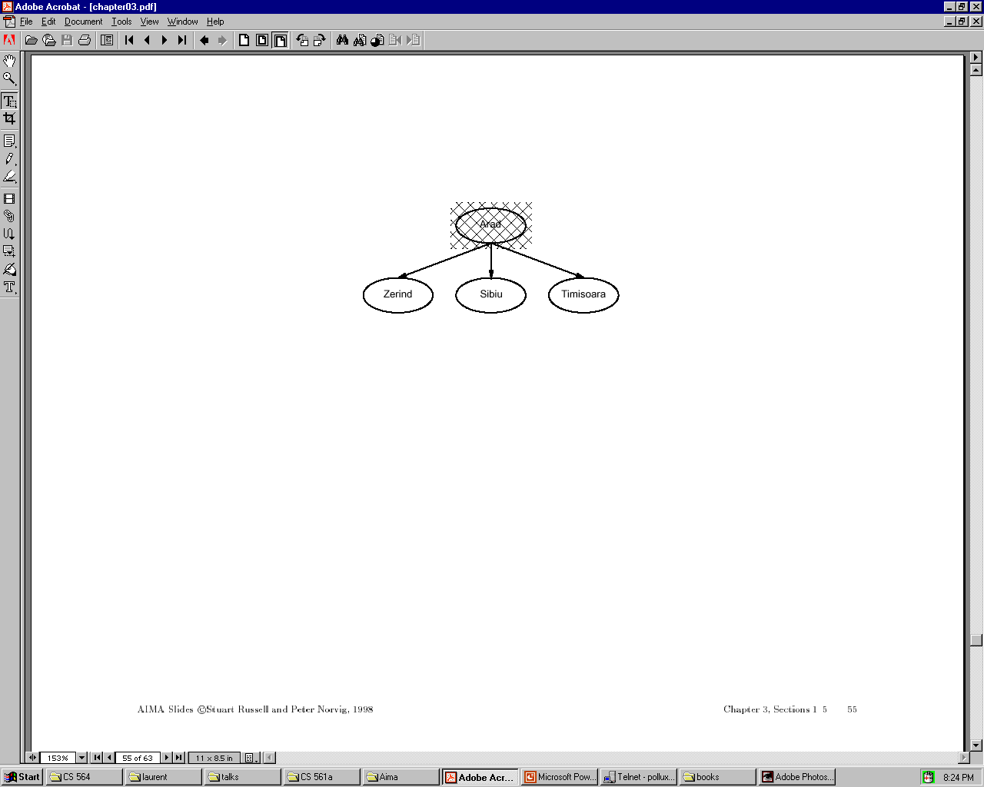

Slide 67


Slide 68


Slide 69
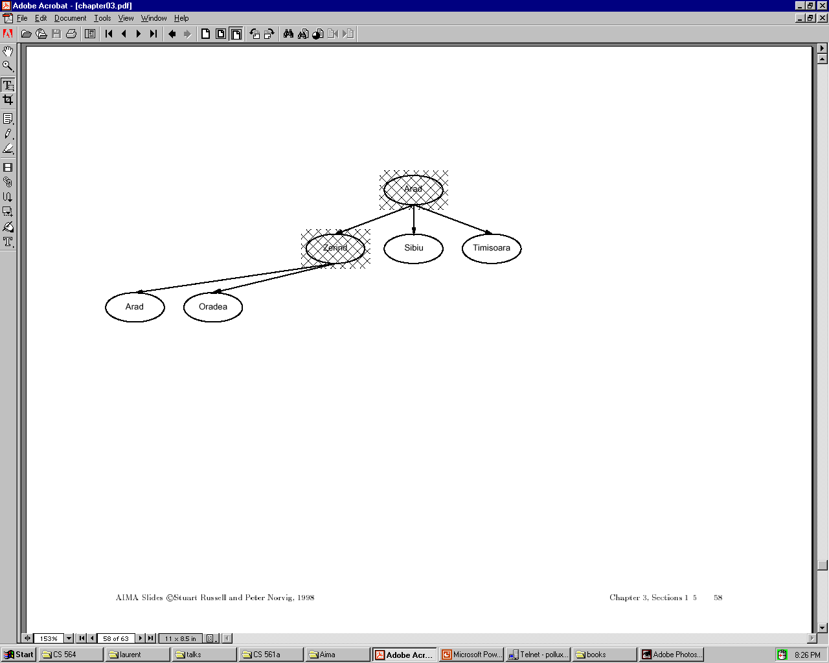

Slide 70
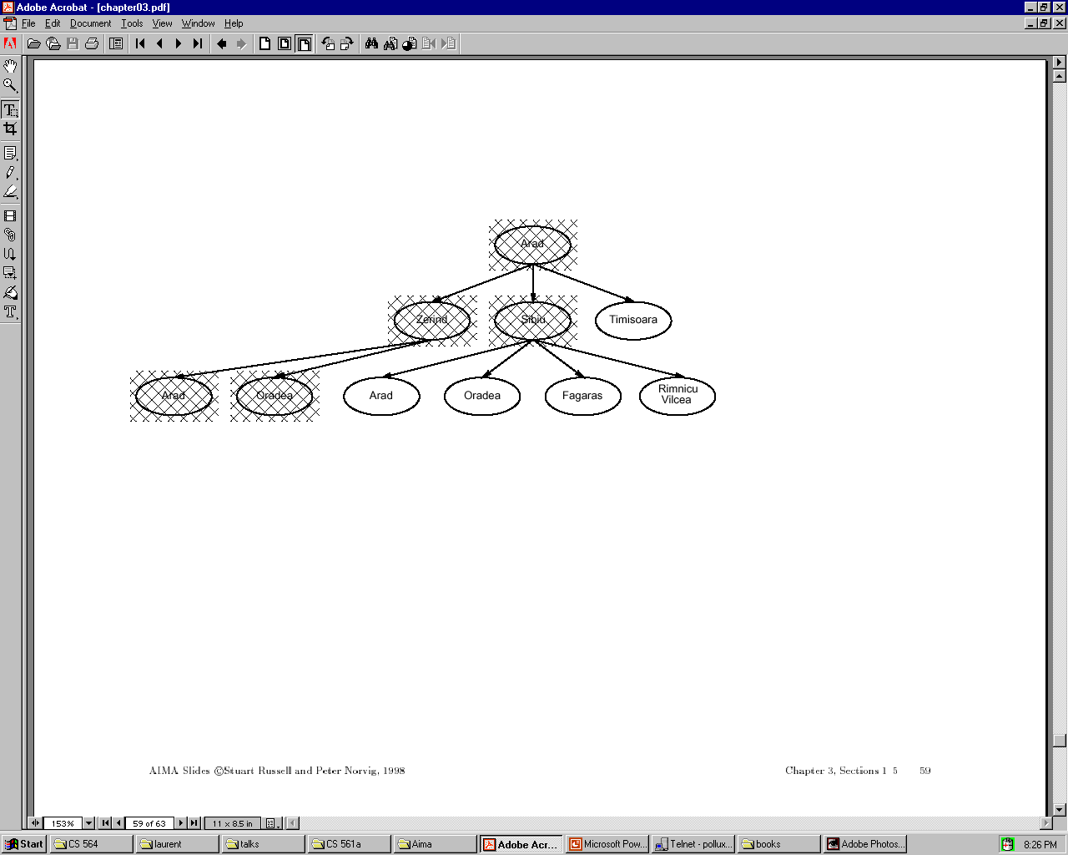

Slide 71
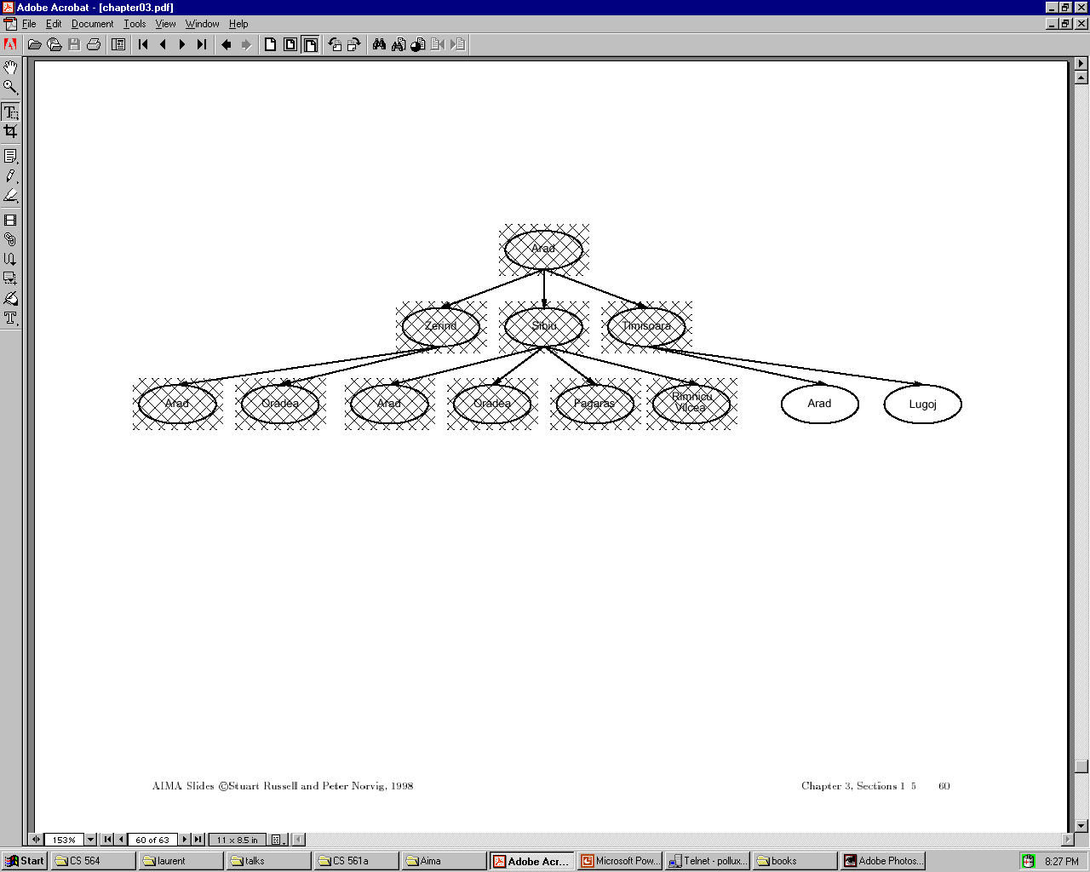

Slide 72
Iterative deepening complexity
Iterative deepening search may seem wasteful because so many states are expanded multiple times.
In practice, however, the overhead of these multiple expansions is small, because most of the nodes are towards leaves (bottom) of the search tree:
thus, the nodes that are evaluated several times
(towards top of tree) are in relatively small number.

Slide 73
Iterative deepening complexity
In iterative deepening, nodes at bottom level are expanded once, level above twice, etc. up to root (expanded d+1 times) so total number of expansions is:
(d+1)1 + (d)b + (d-1)b^2 + … + 3b^(d-2) + 2b^(d-1) + 1b^d = O(b^d)
In general, iterative deepening is preferred to depth-first or breadth-first when search space large and depth of solution not known.

Slide 74
Bi-directional search

Slide 75
Bidirectional search
Both search forward from initial state, and backwards from goal.
Stop when the two searches meet in the middle.
Problem: how do we search backwards from goal??
predecessor of node n = all nodes that have n as successor
this may not always be easy to compute!
if several goal states, apply predecessor function to them just as we applied successor (only works well if goals are explicitly known; may be difficult if goals only characterized implicitly).
Start
Goal

Slide 76
Bidirectional search
Problem: how do we search backwards from goal?? (cont.)
…
for bidirectional search to work well, there must be an efficient way to check whether a given node belongs to the other search tree.
select a given search algorithm for each half.
Start
Goal

Slide 77
Bidirectional search
1. QUEUE1 <-- path only containing the root;
QUEUE2 <-- path only containing the goal;
2. WHILE both QUEUEs are not empty
AND QUEUE1 and QUEUE2 do NOT share a state
DO remove their first paths;
create their new paths (to all children);
reject their new paths with loops;
add their new paths to back;
3. IF QUEUE1 and QUEUE2 share a state
THEN success;
ELSE failure;

Slide 78
Bidirectional search
Completeness: Yes,
Time complexity: 2*O(b ^{d/2}) = O(b ^{d/2})
Space complexity: O(b ^{m/2})
Optimality: Yes
To avoid one by one comparison, we need a hash table of size O(b ^{m/2})
If hash table is used, the cost of comparison is O(1)

Slide 79
Bidirectional Search
Initial State
Final State
d / 2
d

Slide 80
Bidirectional search
Bidirectional search merits:
Big difference for problems with branching factor b in both directions
A solution of length d will be found in O(2b^{d/2}) = O(b^{d/2})
For b = 10 and d = 6, only 2,222 nodes are needed instead of 1,111,111 for breadth-first search

Slide 81
Bidirectional search
Bidirectional search issues
Predecessors of a node need to be generated
Difficult when operators are not reversible
What to do if there is no explicit list of goal states?
For each node: check if it appeared in the other search
Needs a hash table of O(b^{d/2})
What is the best search strategy for the two searches?

Slide 82
Comparing uninformed search strategies
Criterion Breadth- Uniform Depth- Depth- Iterative Bidirectional
first cost first limited deepening (if applicable)
Time b^d b^d b^m b^l b^d b^(d/2)
Space b^d b^d bm bl bd b^(d/2)
Optimal? Yes Yes No No Yes Yes
Complete? Yes Yes No Yes, Yes Yes
if l≥d
b – max branching factor of the search tree
d – depth of the least-cost solution
m – max depth of the state-space (may be infinity)
l – depth cutoff

Slide 83
Summary
Problem formulation usually requires abstracting away real-world details to define a state space that can be explored using computer algorithms.
Once problem is formulated in abstract form, complexity analysis helps us picking out best algorithm to solve problem.
Variety of uninformed search strategies; difference lies in method used to pick node that will be further expanded.
Iterative deepening search only uses linear space and not much more time than other uniformed search strategies.

